Slide 1

ANALYSIS OF FRAGMENTATION CROSS SECTIONS
OF GSI 2021 DATA
FOR THE FOOT EXPERIMENT
Alma Mater Studiorum - Università di Bologna
Submitted by:
Giacomo Ubaldi
Supervisor:
Prof. Matteo Franchini
Co-supervisors:
Dr. Riccardo Ridolfi
Dr. Roberto Zarrella
28/10/2022

Slide 2

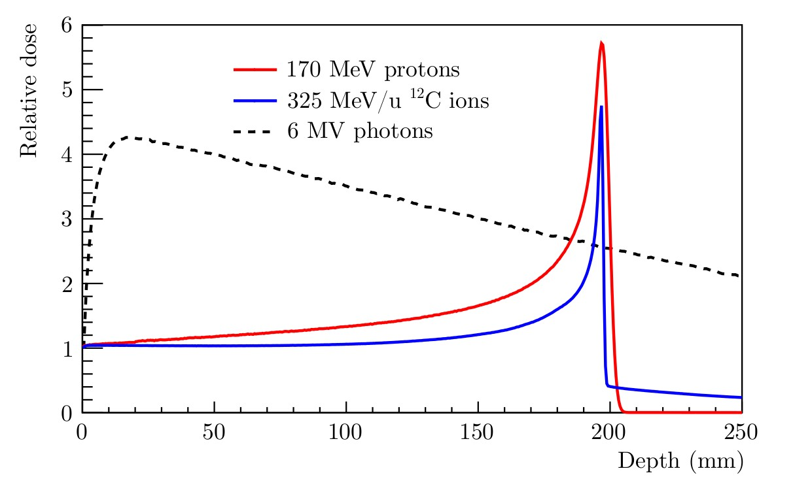

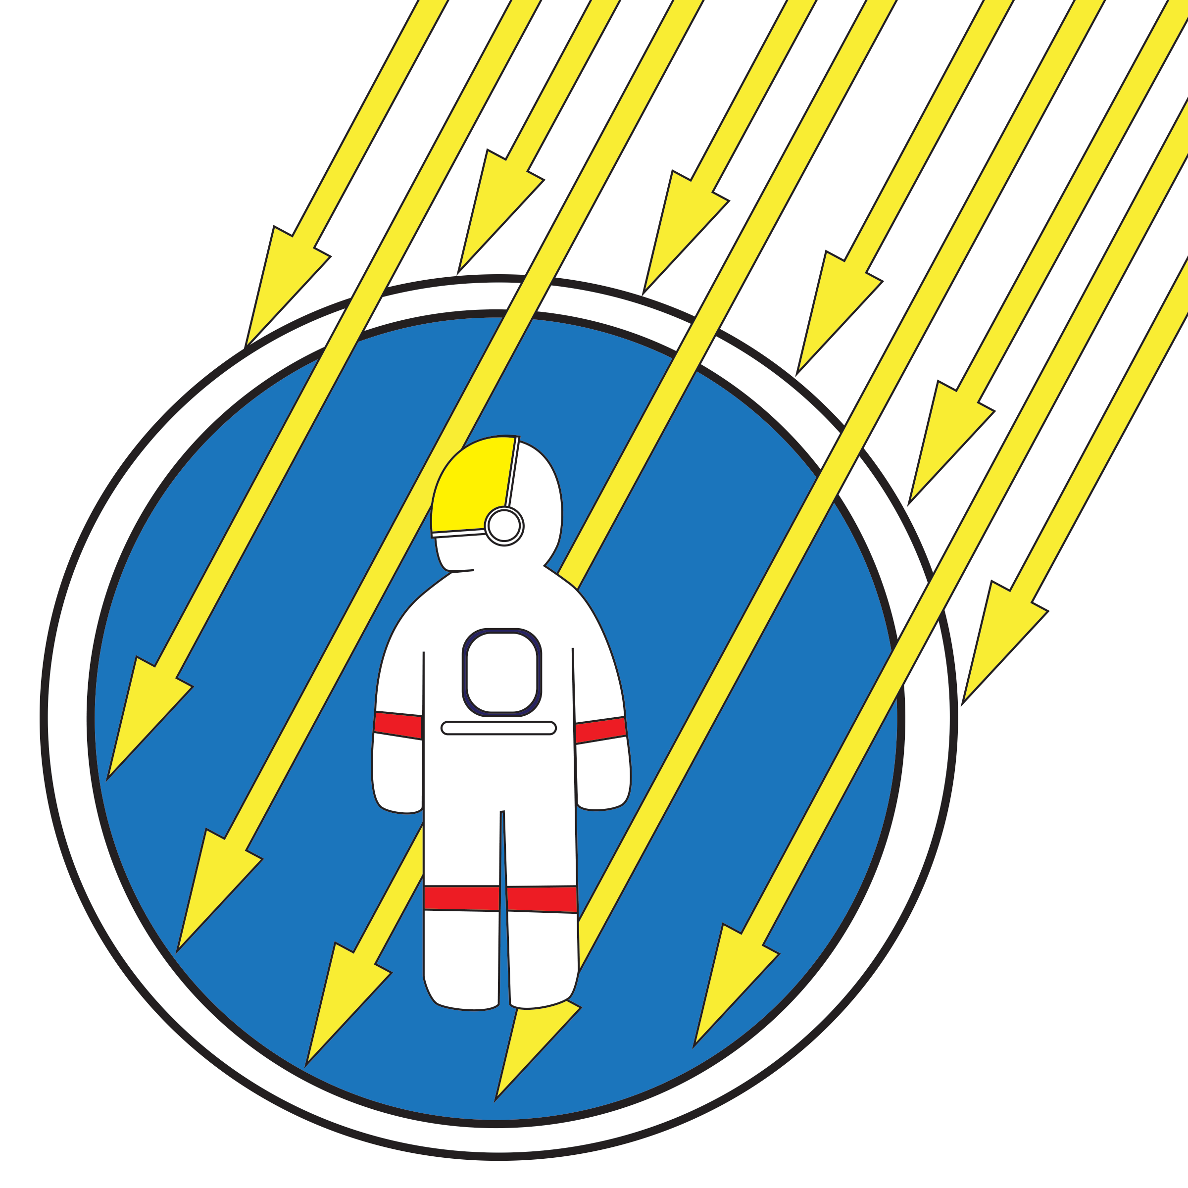


FOOT Applications
Hadrontherapy treatments:
spear of healthy tissues
Space radioprotection:
shelding from cosmic
secondary fragments
Charged particles interaction with matter:
Localized dose profile
1
Giacomo Ubaldi

Slide 3

FOOT Applications
Hadrontherapy treatments:
spear of healthy tissues
Space radioprotection:
shelding from cosmic
secondary fragments
Charged particles interaction with matter:
Localized dose profile
Nuclear Fragmentation
1
Giacomo Ubaldi

Slide 4


The FOOT experiment
Goal:
double differential nuclear fragmentation cross section measurements with uncertainty < 5%
Fixed target collisions
Beam energies between 200 MeV/u and 700 MeV/u for hadrontherapy and space radioprotection topics
table top setup to be moved according to beam facility availability
z
BEAM
2
Giacomo Ubaldi

Slide 5
The FOOT experiment
Goal:
double differential nuclear cross sections mesurements with uncertainty < 5%
Particle identification by measuring all kinematic quantities
Beam
monitor
Target
Start Counter
2
z
BEAM
Pre-target region
2
Giacomo Ubaldi

Slide 6
The FOOT experiment
Goal:
double differential nuclear cross sections mesurements with uncertainty < 5%
Particle identification by measuring all kinematic quantities
Vertex
Tracker
Inner
Tracker
Microstrip Silicon
Detector
z
BEAM
Permanent
Magnets
Tracking region
2
Giacomo Ubaldi

Slide 7
The FOOT experiment
Goal:
double differential nuclear cross sections mesurements with uncertainty < 5%
Particle identification by measuring all kinematic quantities
ToF Wall
Calorimeter
z
BEAM
Downstream region
2
Giacomo Ubaldi

Slide 8


GSI 2021 Analysis
Data-taking at GSI (Darmstadt, Germany) in 2021
¹⁶O 400 MeV/u on 5 mm C target
Partial setup: no magnet, only one module of calorimeter
TW
MSD
BM
VTX
SC
CALO
TG
Specific goal:
Elemental fragmentation cross section
Angular differential cross section for every charge
3
Giacomo Ubaldi

Slide 9
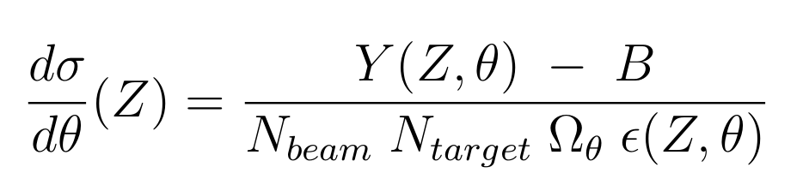
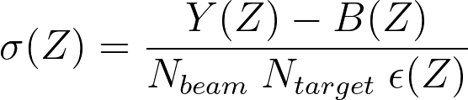
Analysis procedure
To compute elemental cross section and angular differential cross section:
Y: fragment distribution
B: background source
N_{beam}: n° of primary events
N_{target}: n° of scattered centers per unit area
ε: efficiency
Ω_{ϑ}: angular phase space
Event reconstruction in SHOE
Analysis procedure in Python code (from scratch)
4
Giacomo Ubaldi

Slide 10
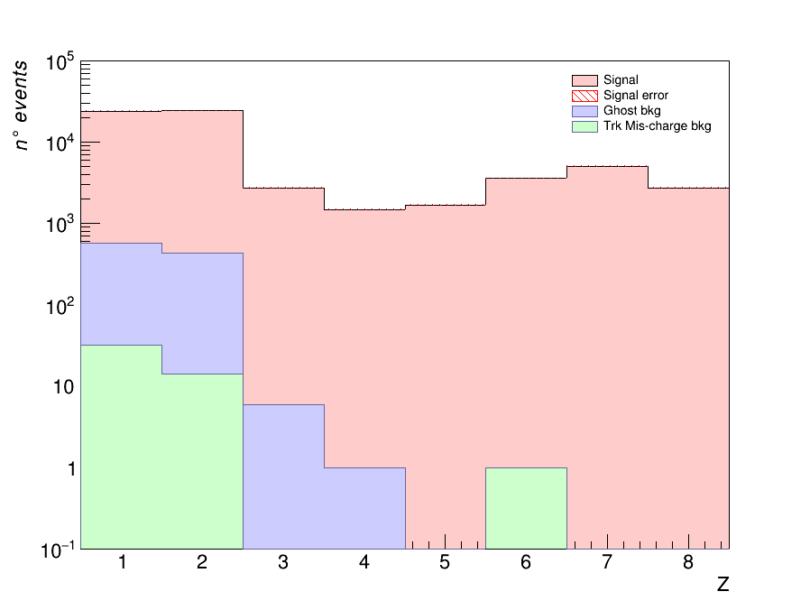
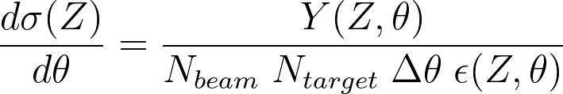
Analysis procedure
Starting from a MC dataset of 10⁶ events generated
by FLUKA to simulate detectors and beams
of GSI 2021 campaign.
Z yield and Bkg sources
Z yield of all fragments
2) Yield of Z obtained from reconstructed tracks
    Exploiting charge reconstruction algorithm
    Exploiting tracking reconstruction algorithm
    Simulating a “trigger” in order to consider
    only fragments
3) Background obtained from MC cuts on:
    Charge algorithm mis-reconstruction
    Tracking algorithm mis-reconstruction
5
Giacomo Ubaldi

Slide 11
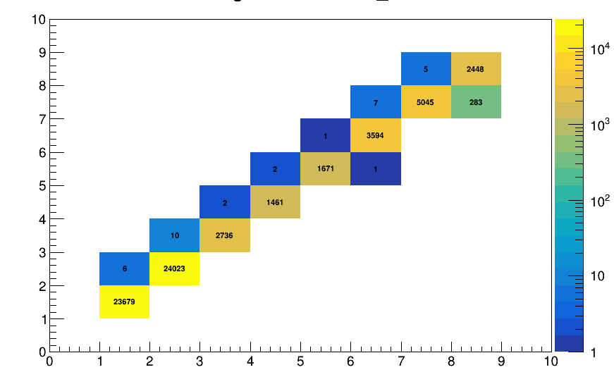
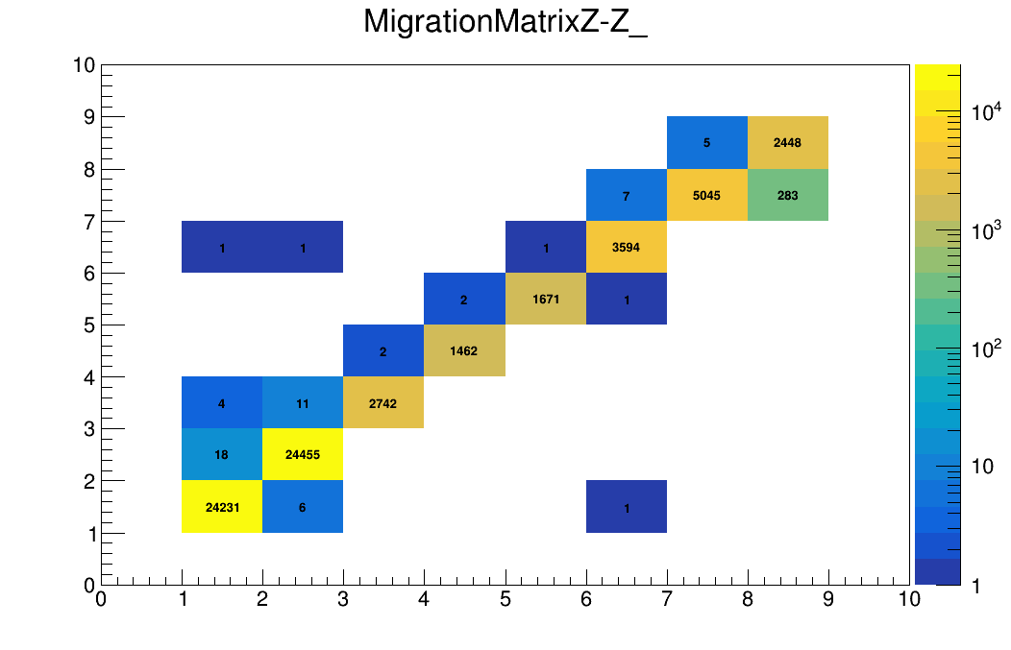
Analysis procedure
Before and after background removal: more diagonal migration matrix → less noise sources
Z_{reco}
Z_{reco}
Z_{true}
Z_{true}
6
Giacomo Ubaldi

Slide 12
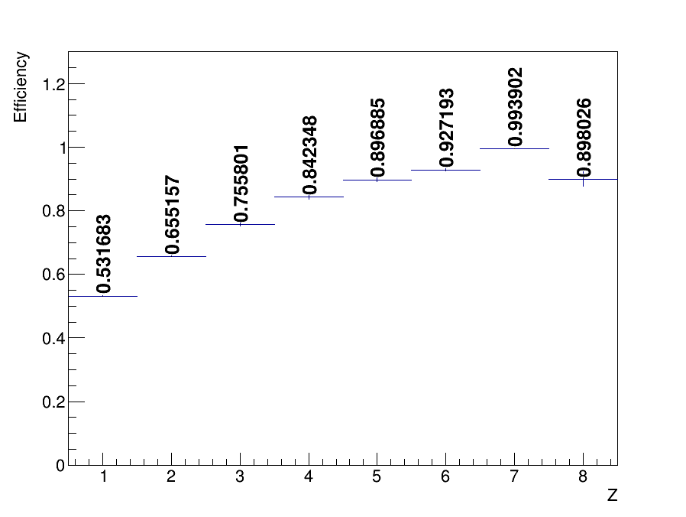
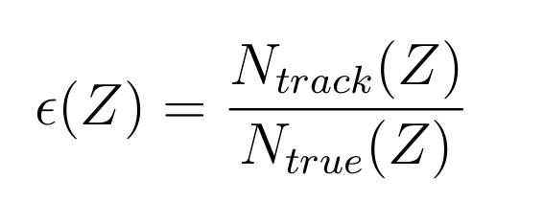
Analysis procedure
4) Track efficiency obtained as:
where
N_{track} is obtained by tracking algorithm
N_{true} are particles from the generated simulation
7
Giacomo Ubaldi

Slide 13
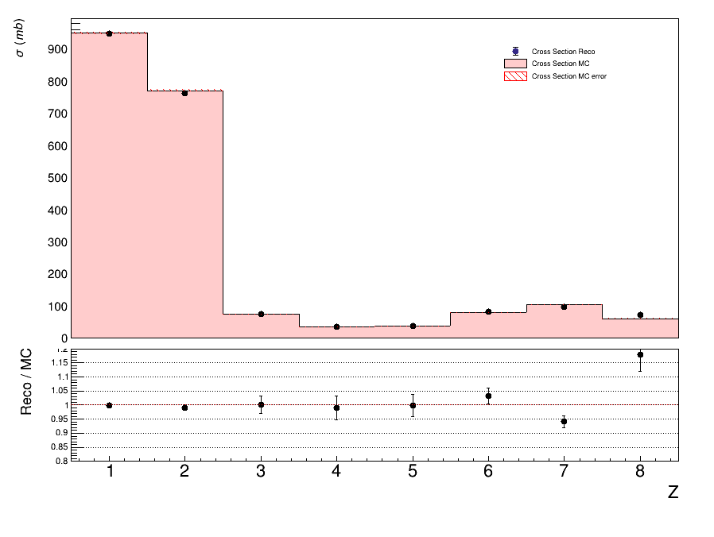
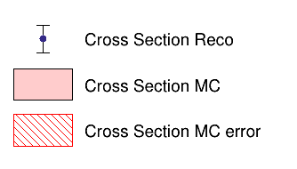
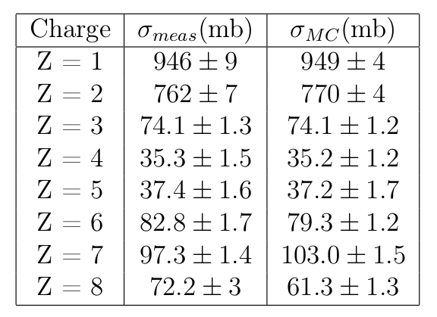
MC Closure test - elemental cross section
comparing the MC data-like cross sections with the MC generated ones.
understand the reliability of the analysis chain and algorithms ➔ solid analysis
1.2
1
0.8
8
Giacomo Ubaldi

Slide 14
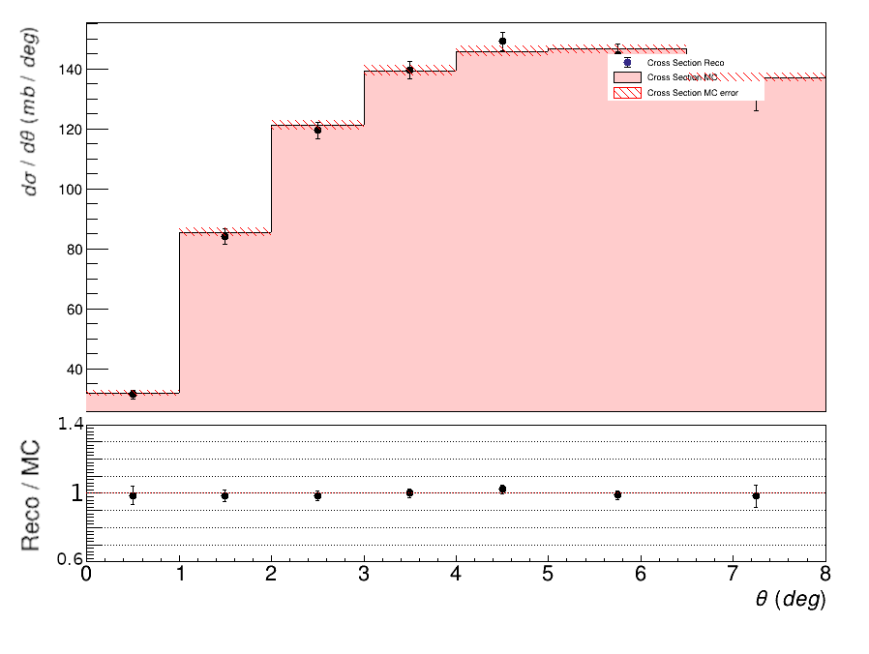
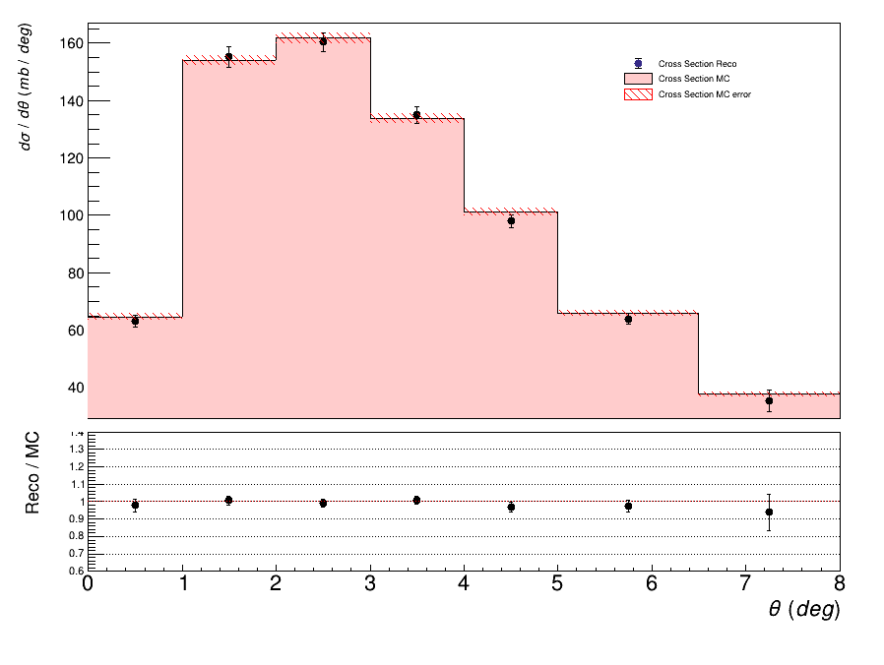
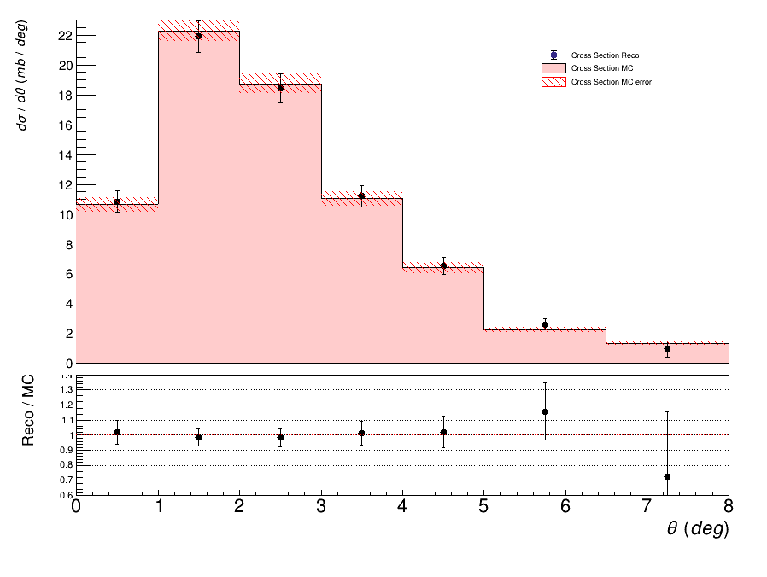
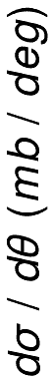

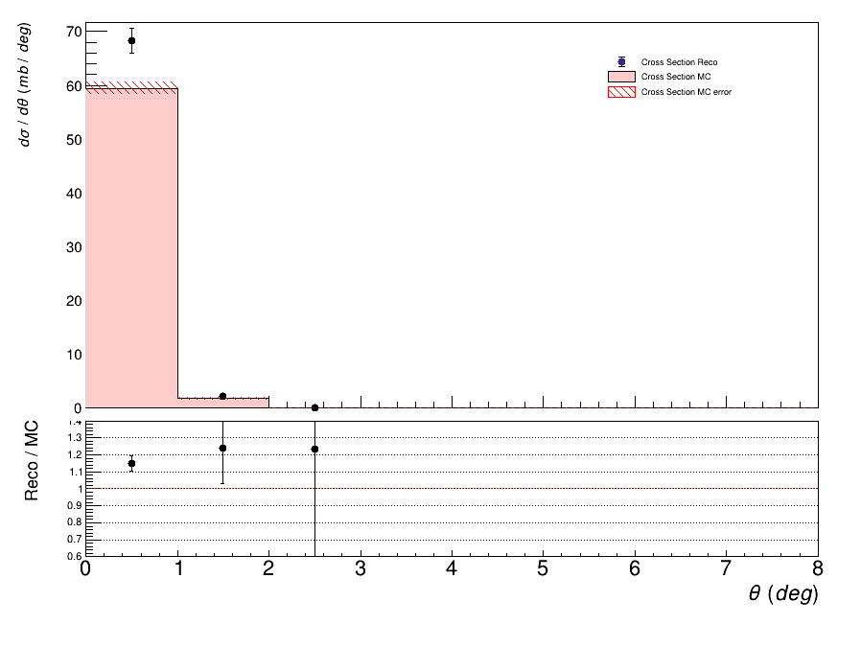
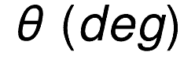
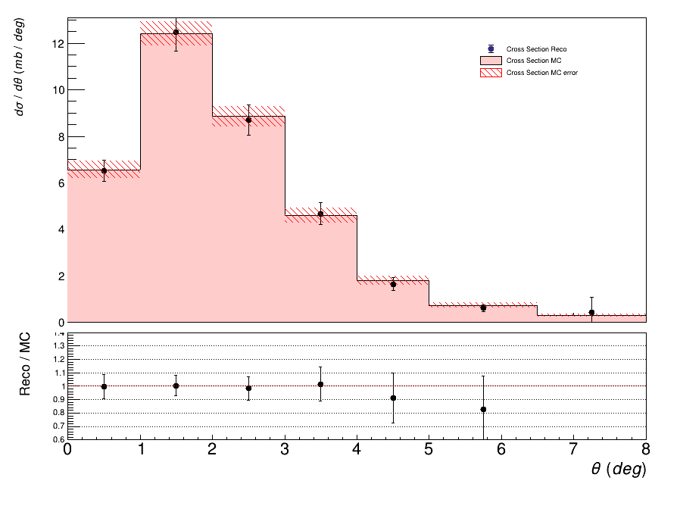
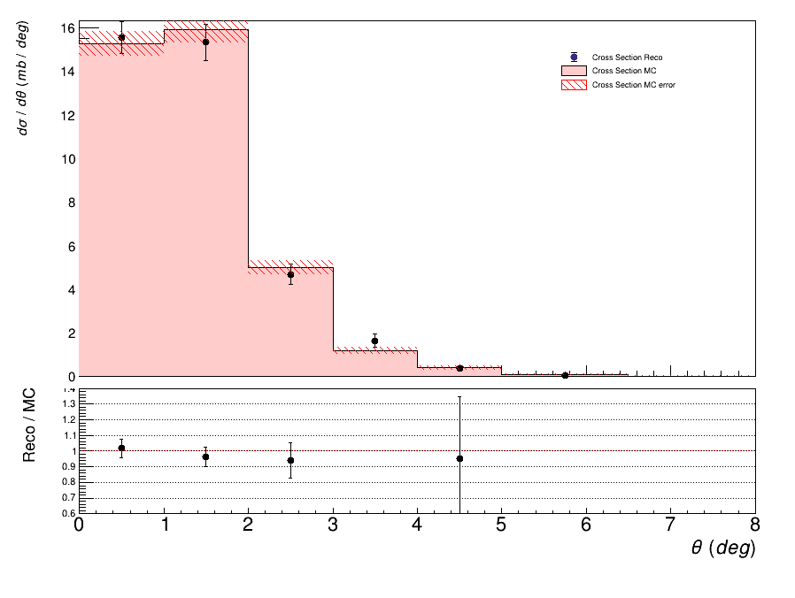
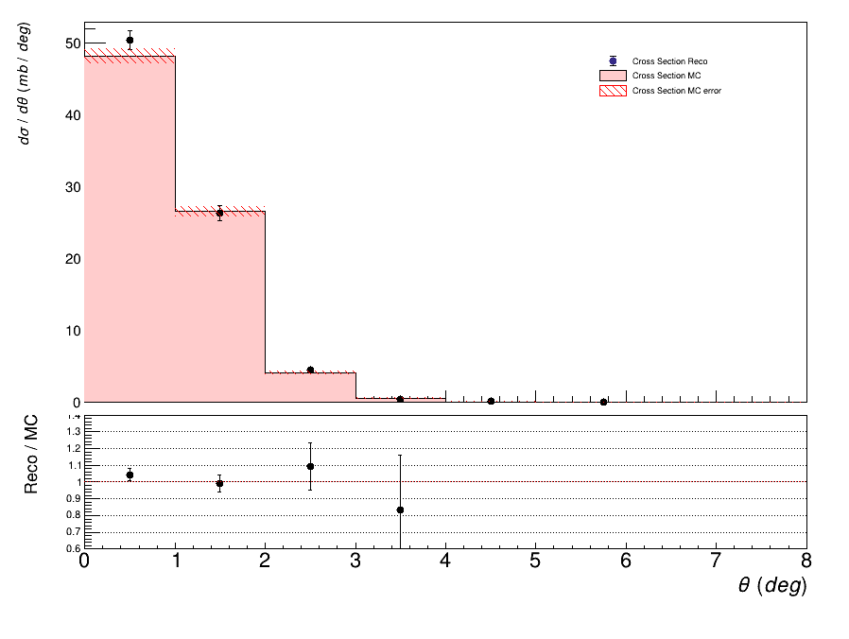
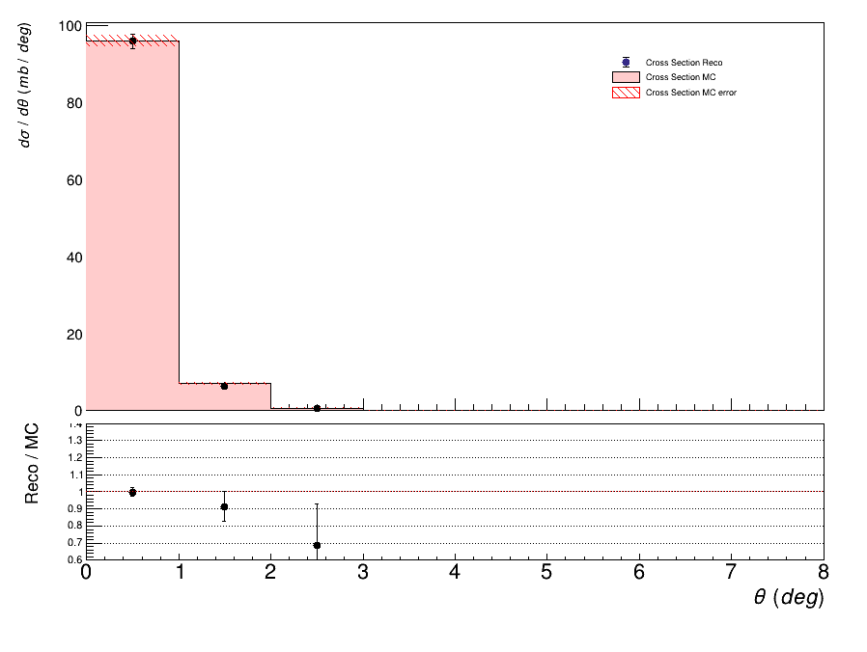
MC Closure test - angular differential cross section
1.4
1.4
1.4
1.4
1
1
1
1
0.6
0.6
0.6
0.6
Z=1
Z=2
Z=3
1.4
z=8
1.4
1.4
1.4
1.4
1.4
1.4
1.4
1
1
1
1
1
1
1
1
0.6
0.6
0.6
0.6
0.6
0.6
0.6
0.6
9
Z=4
Z=5
Z=6
Z=7

Slide 15
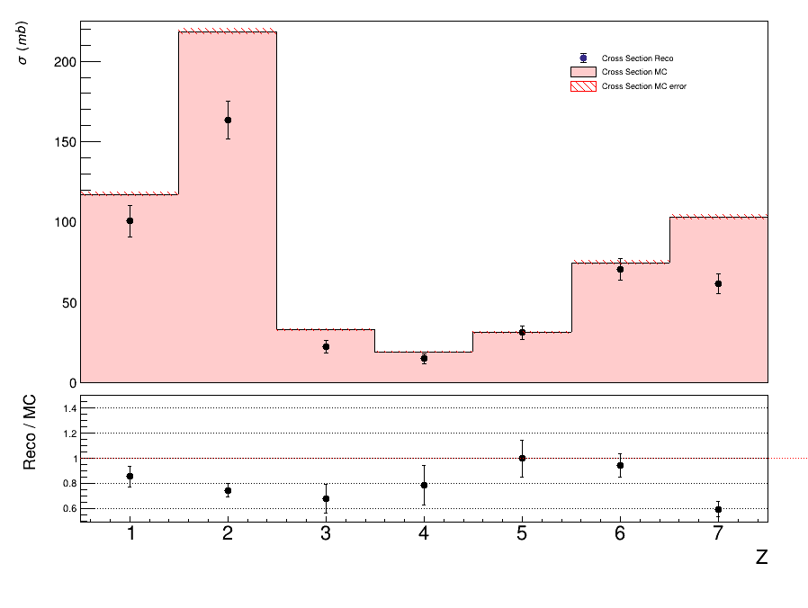
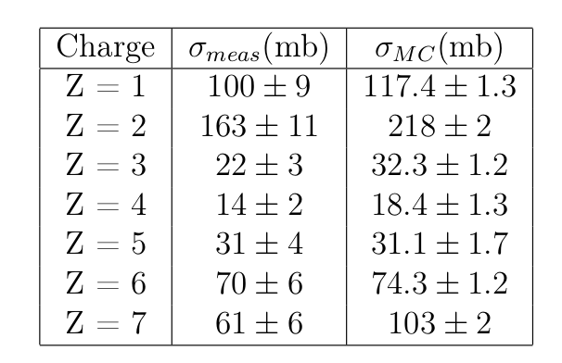
Experimental results - elemental cross section
Yield obtained from run 4306 taken in GSI 2021 campaign
Fiducial cross section (θ<2.5°) to limit overall noise
➔ high consistency
10
Giacomo Ubaldi

Slide 16
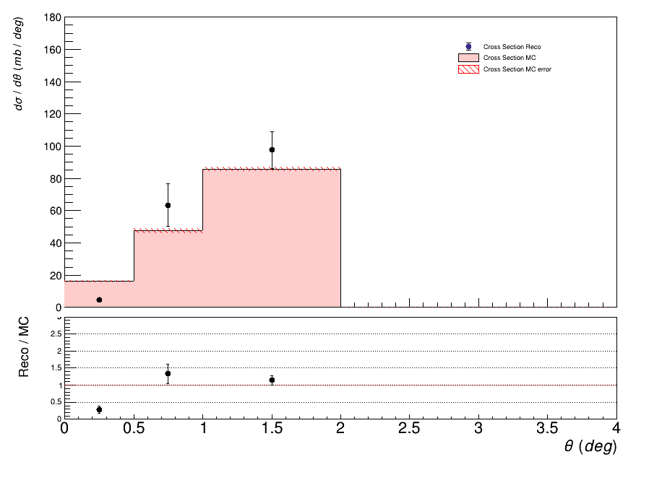
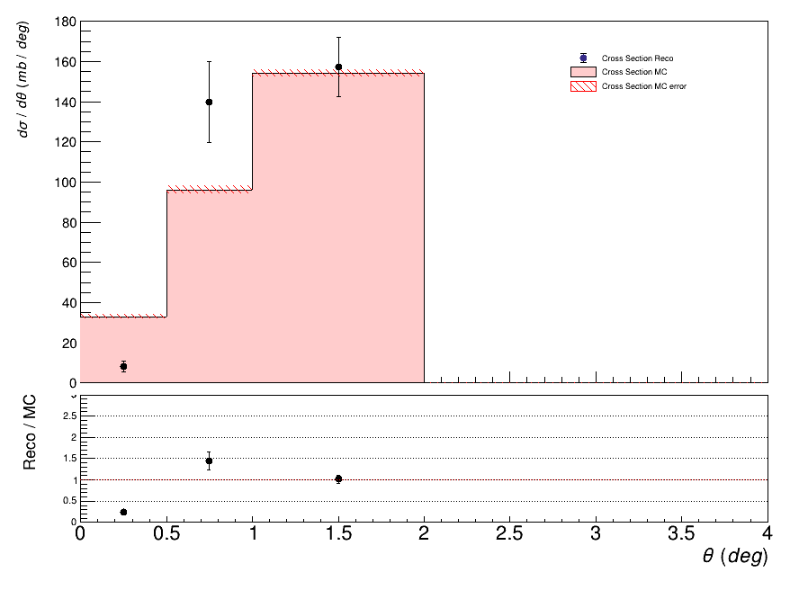
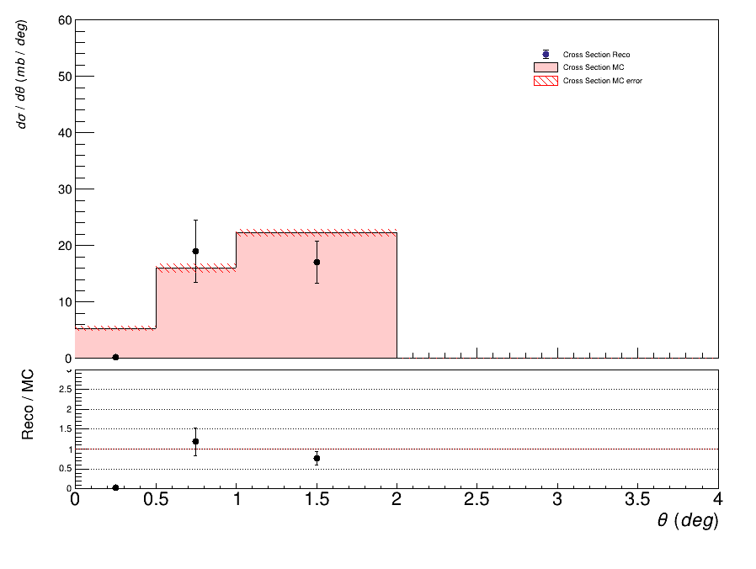
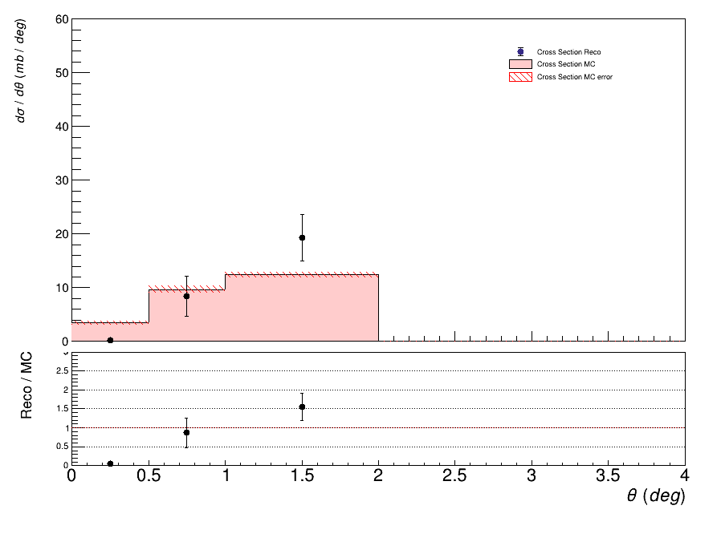
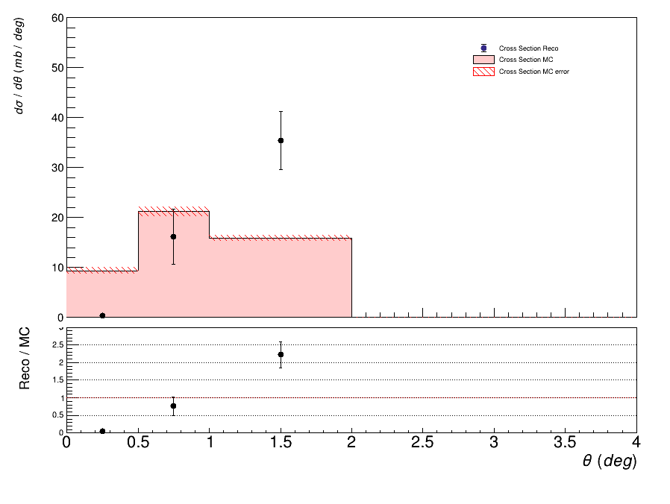
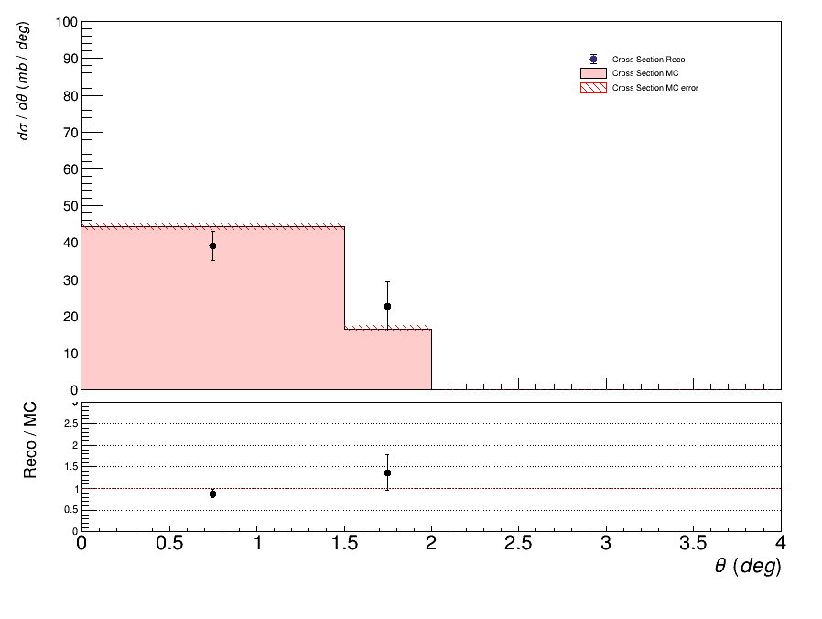
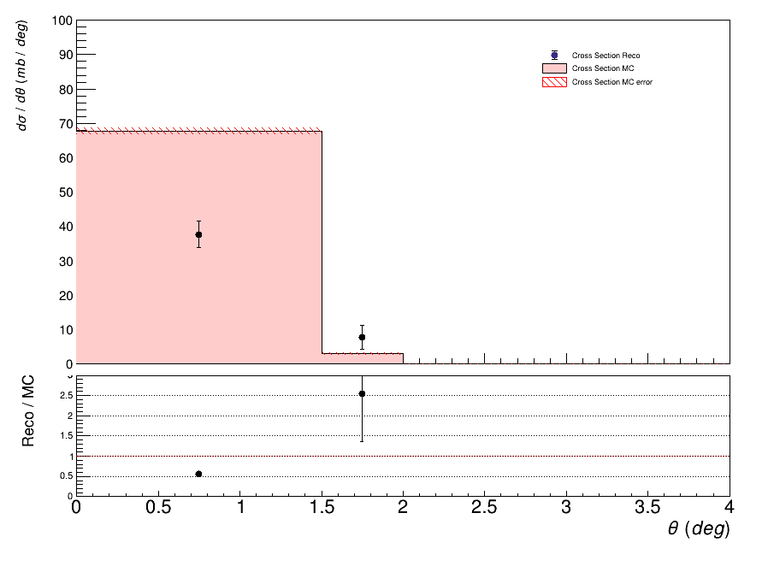
Experimental results - angular differential cross section
1.4
1.4
1.4
1
1
1
0.6
0.6
0.6
Z=1
Z=2
Z=3
1.4
1.4
1.4
1.4
1
1
1
1
0.6
0.6
0.6
0.6
11
Z=4
Z=5
Z=6
Z=7

Slide 17

Conclusions
Study of background sources, corrections and efficiencies on MC level
Analysis strategy checked by MC events with a solid closure test
First preliminary results of experimental cross sections with high consistency
Foundation structure of analysis for further data takings with the overall setup
Future prospectives:
Detailed allignment and systematics uncertainties
Including unfolding to correct for migrations
Evaluating cross section differential also in kinematic energy and in mass
Thank you for the attention
12
Giacomo Ubaldi

Slide 18
Backup slides

Slide 19


Hadrontherapy
tumor
Hadrontherapy vs radiotherapy:
Finite range
Localized dose profile
Spare of healthy tissues
Nuclear Fragmentation
1
Giacomo Ubaldi

Slide 20
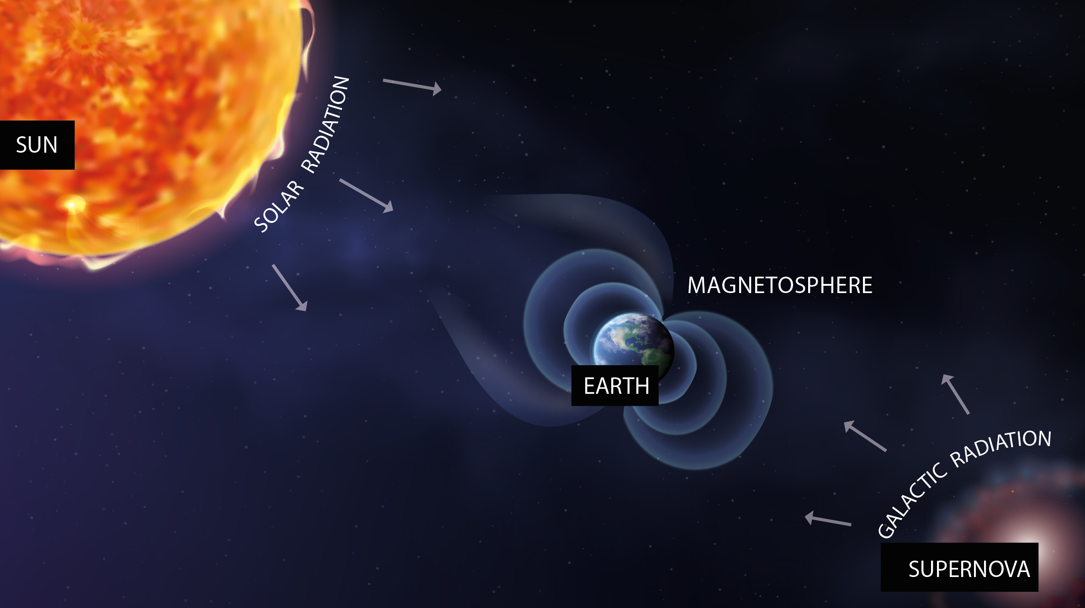


Space radioprotection
MARS

Slide 21
Space radioprotection
MARS
SOLAR RADIATION
suddenly
92% p
6% He
2% HZE
E<1 GeV/n

Slide 22

Space radioprotection
COSMIC RAYS
constantly
90% p
9% He
1% HZE
0.001 < E < 10¹⁴ GeV/n

Slide 23



Space radioprotection
MARS

Slide 24
Space radioprotection
MARS
fragmentation
Effects on:
- Space craft hull and structure
- Shielding
- Astronaut’s body

Slide 25
Space radioprotection
MARS
fragmentation
Dose equivalent
Dose
Fluence

Slide 26


Nuclear fragmentation
Proton beam:
~ 200 MeV
Target fragments:
Short range
High energy impact in entrance channel
Carbon beam:
Projectile fragments:
Longer range than beam
Dose beyond the Bragg peak
~ 400 MeV/u

Slide 27
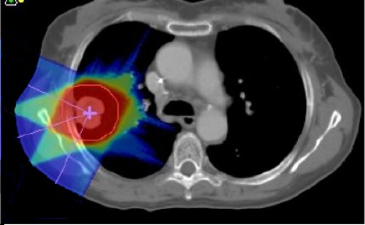

Nuclear fragmentation
Proton beam:
~ 200 MeV
Carbon beam:
Projectile fragments:
Longer range than beam
Dose beyond the Bragg peak
~ 400 MeV/u
nuclear cross section
mesurements needed

Slide 28

GSI 2021 Analysis
Data-taking at GSI (Darmstadt, Germany) in 2021
¹⁶O 400 MeV/u and 200 MeV/u on 5 mm C target
Partial setup: no tracker, only one module of calorimeter
Specific goal:
Elemental (charge differential) fragmentation cross section
Angular charge double differential cross section

Slide 29

Differential Cross section
Yield of all fragments
Background
unfolding
efficiency
N° of primary
events
N° of scattered
centers
Phase space

Slide 30
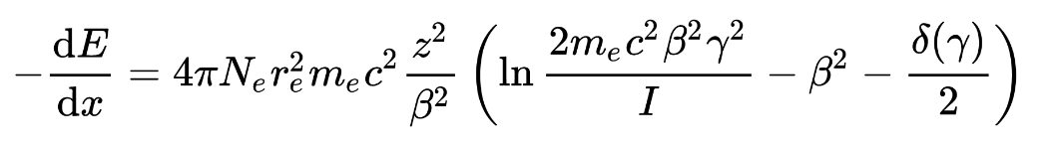

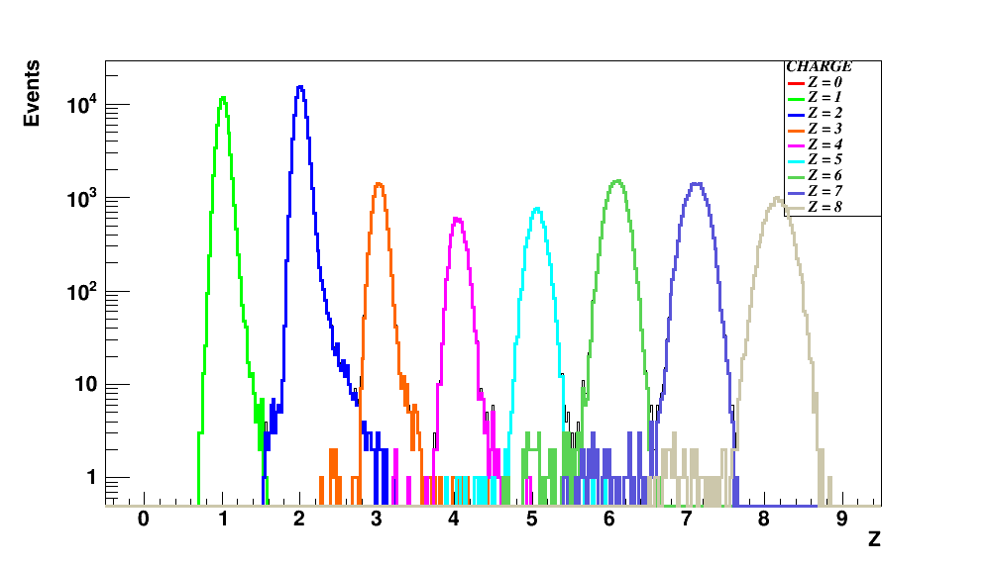
Fragments identification
From Bethe – Bloch formula I can get z:
Infos taken from SC and TW
dE
z=8
z=7
z=6
z=5
z=4
z=3
z=2
z=1
ToF
Charge discrimination
TW charge reconstruction algo

Slide 31
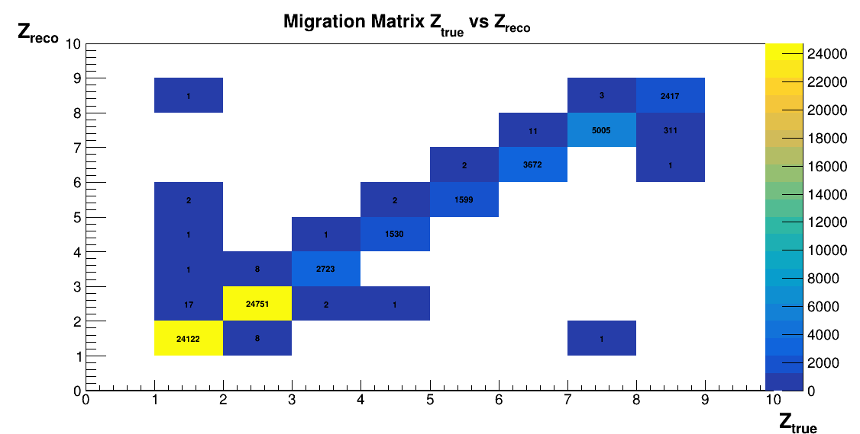
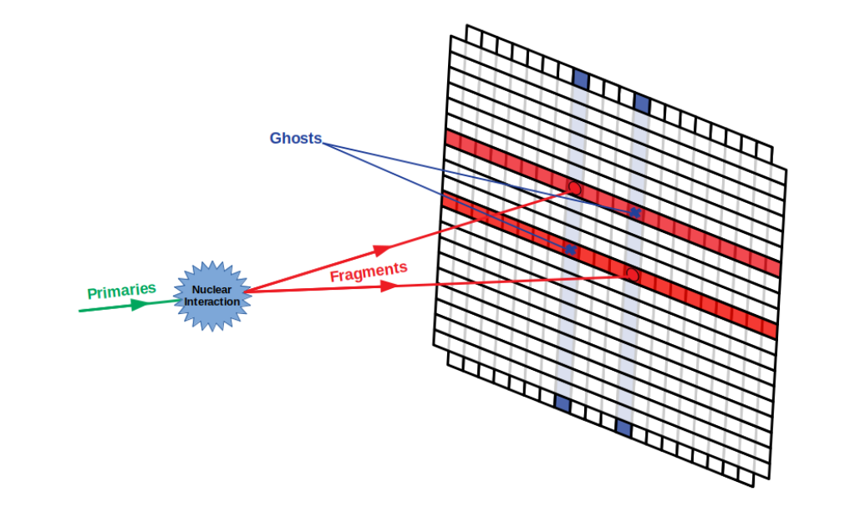
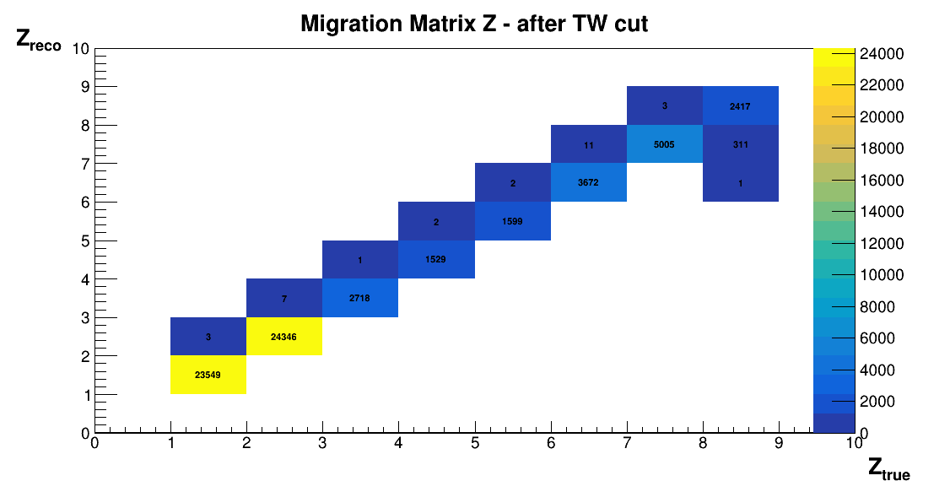
Example: Track reconstruction
It is possible that every bar layer of the TW is hit by more than a fragment at the same time:
multiple hits / ghost hits mis-reconstruction
TW
Applying TW cut:
Matrix more diagonal
6

Slide 32
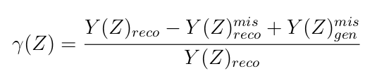
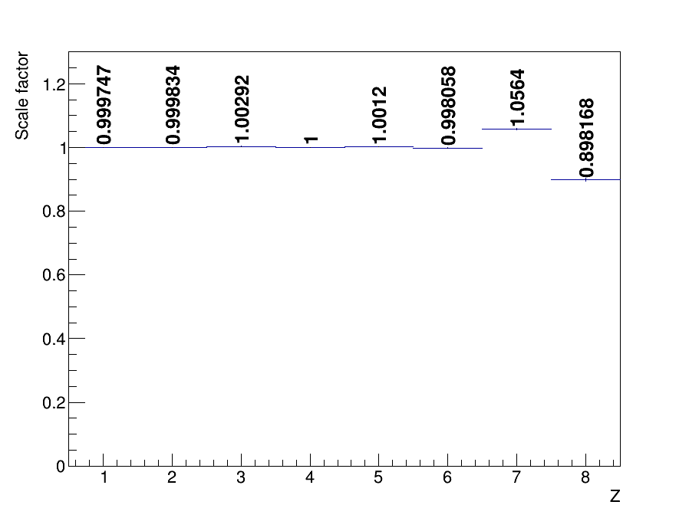
Analysis procedure
Migration matrix correction as
scale factor:
7
Giacomo Ubaldi

Slide 33
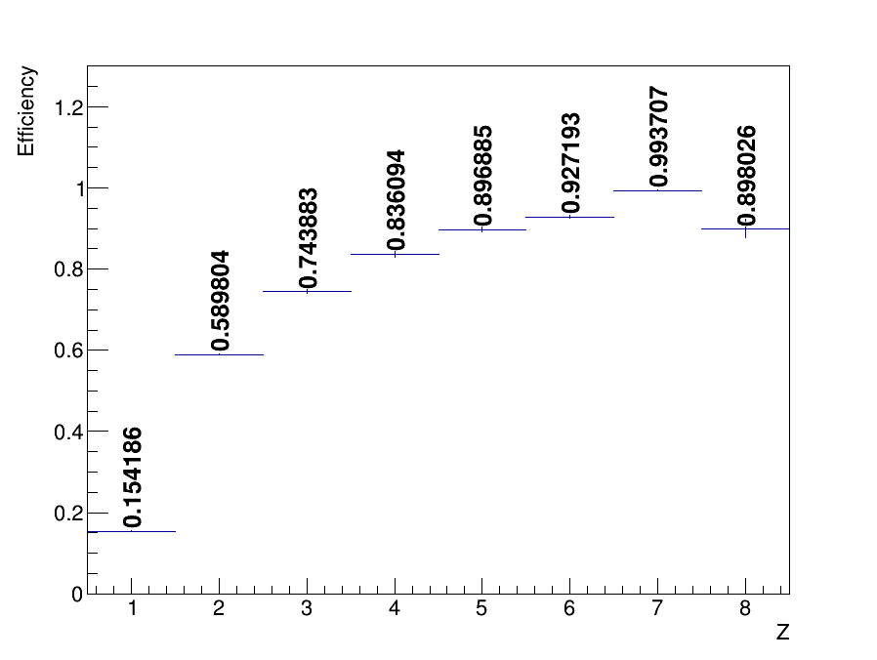
Analysis procedure
4) Track efficiency obtained as:
where track is obtained by tracking algorithm
MC particles are from the generated simulation
Total Track efficiency
Fiducial Track efficiency
7
Giacomo Ubaldi

Slide 34
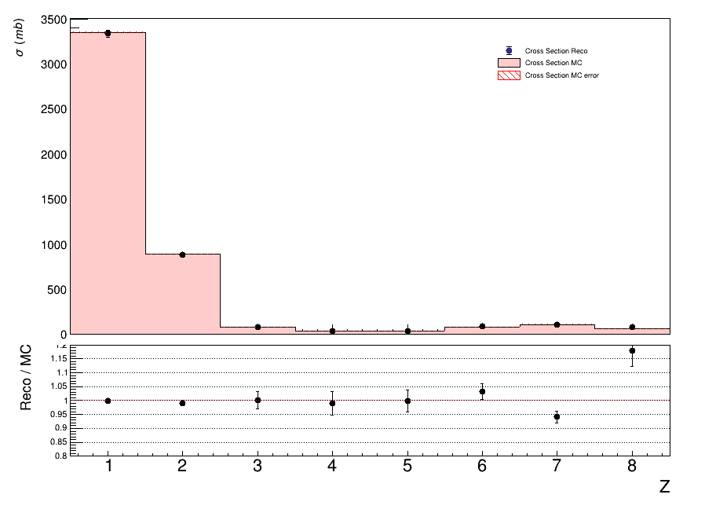
MC Closure test elemental cross section
understand the reliability of the analysis chain and algorithms
comparing the MC data-like cross sections with the MC generated ones.
Total cross section
Fiducial cross section
7
Giacomo Ubaldi

Slide 35
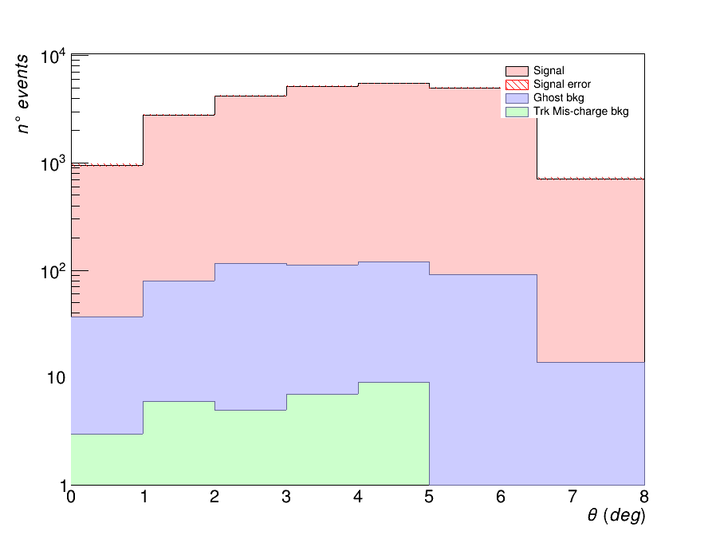
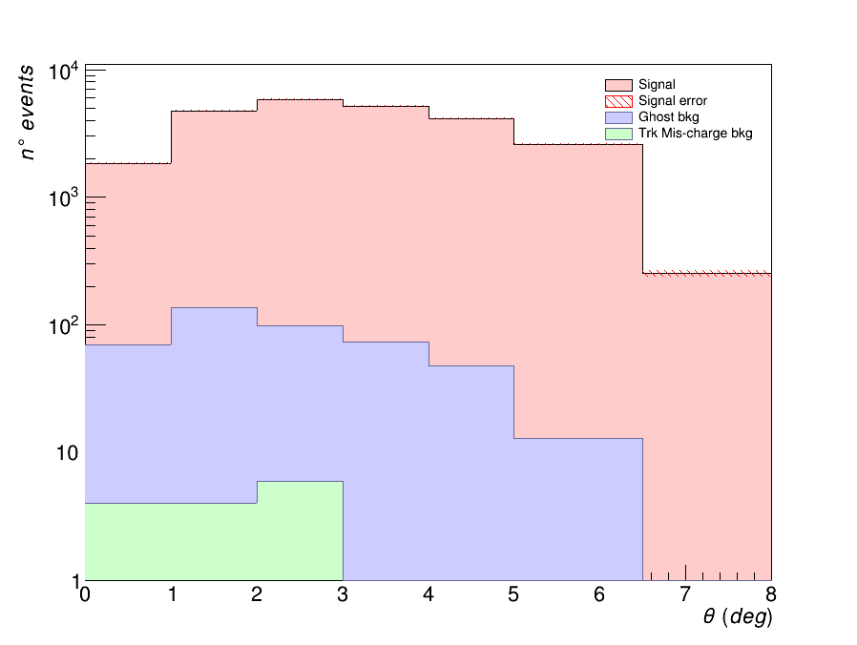
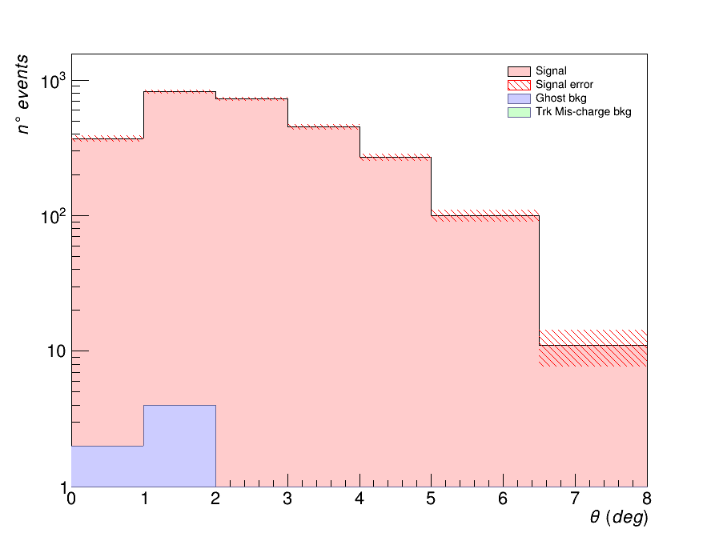
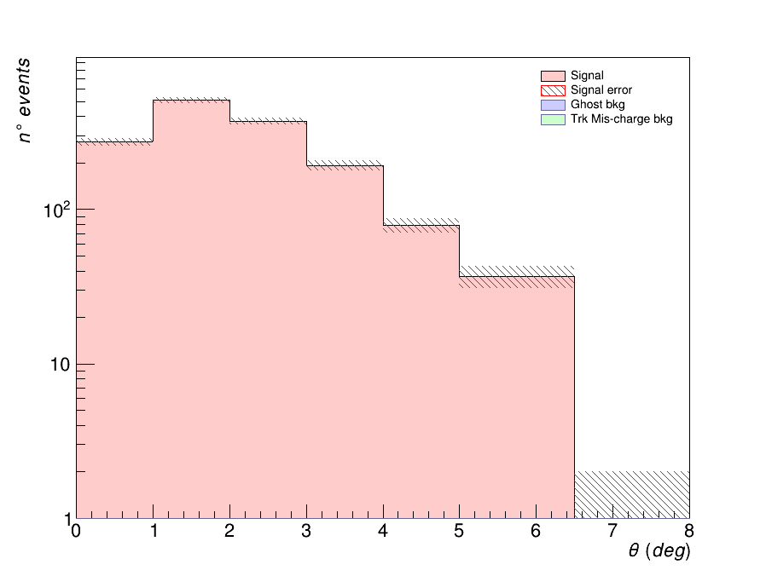
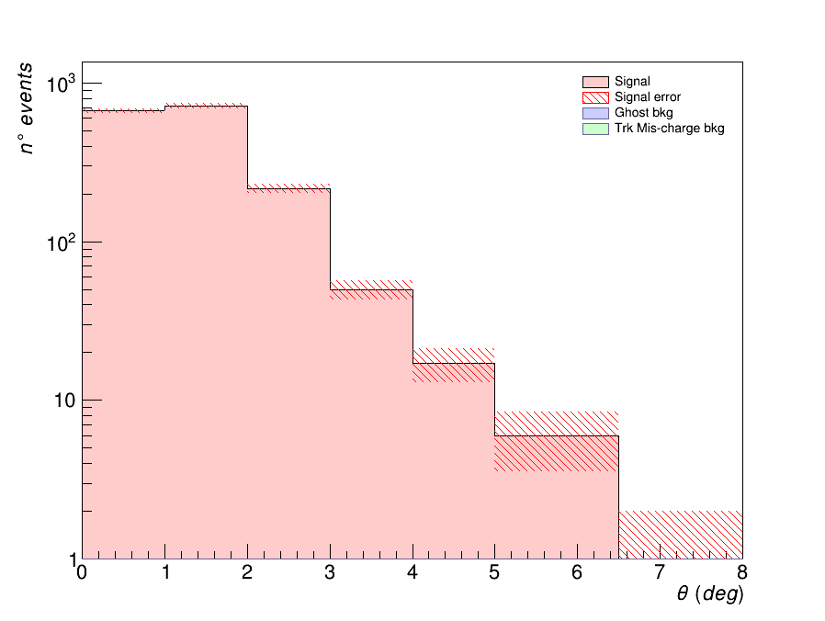
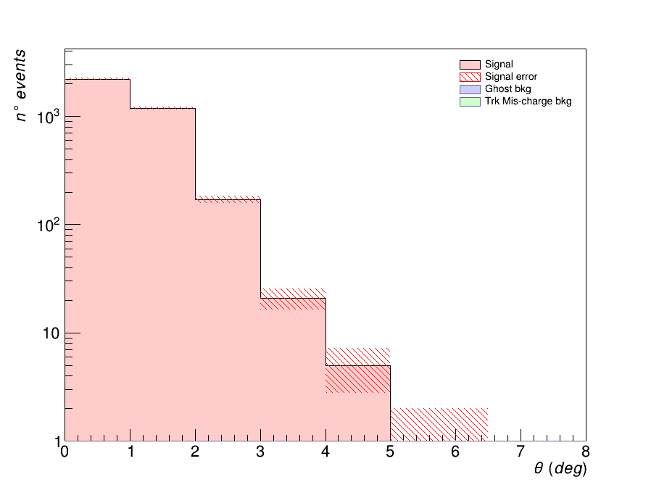
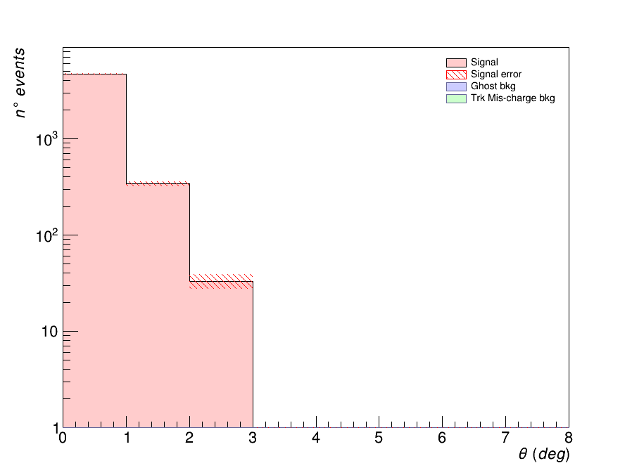

MC – Angular yields and Bkg
z=1
z=4
z=1
z=2
z=3
5
z=5
z=6
z=7
z=8

Slide 36








MC - Angular efficiencies
z=1
z=2
z=3
z=4
7
z=5
z=6
z=7
Giacomo Ubaldi
z=8

Slide 37

Kalman Filter
1. Take an ideal particle in vacuum. If we
add air + detector layers, trajectory
changes due to M.S. and energy loss.
2. We’ll see some measurement hits on
the detector layers (considering finite
detector uncertainty).
3. Propagate the first hit to the next
layer. Propagator Matrix F.
4. Find the best compromise between
the propagated point and the closest
hit on the 2 nd layer. Use a Chi2 and a
Projection Matrix H.
5. Iterate 3 and 4 for the next layers.

Slide 38



Track reconstruction
TW
MSD
VT
track reconstruction on GSI 2021 data
No B field present
Kalman Filter reconstruction of a track
Start from VT tracklets
Projection to possible planes of IT
KF extrapolation to MSD
KF extrapolation to TW
Fit the track candidates and extract reconstructed quantities: Z, momentum ...

Slide 39

Trigger Simulation
Fragment Trigger is fired every time Minimum Bias condition on TW is not verified

Slide 40

Trigger Simulation
Applying Trigger cut:
Z_{reco}
Z_{true}
Main source of mis-reconstruction is given by O due to its high statistics

Slide 41
Reconstruction, Track Algo
Another source of systematics can be the way points are collected in a track
In the best scenario, all points belong to the same particle:
Reconstructed track:
x
x
x
x
x
x
x
x

Slide 42
Reconstruction, Track Algo
However, due to the presence of a lot of secondary fragmentation, some points can belong to other particles.
Reconstructed track:
x
x
x
x
x
x
x
x
Wrong points collected in the track
The McId of the track is given by the most present particle in the collection
However, if the TWPoint is of another particle → its McId is different
→ filter out all the tracks in which McId_{track} ≠ McId_{TWPoint}

Slide 43




Pile-up removal
What it was seen in the last data taking (GSI - CNAO 2021) is that the beam flux is not constant → pile-up events
2 crosses
4 crosses
constant
threshold
discrimination
method
2 crosses
4 crosses
Single projectile
Pileup projectile
Single projectile: 4 crosses
pileup projectile: >4 crosses

Slide 44


Pile-up removal
Both minimum bias trigger and trigger fragmentation
Charge
t(ns)
t(ns)
PileUp on 600.000 events ~ 1%

Slide 45






Isotopes identification
Mass reconstruction using all FOOT subdetectors:
In our data no tracker and calorimeter → mass measurement only in MC data!
Augmented Lagrangian Method
Aχ 2 = 11.66 ± 0.38
risoluz. 3.2 %
χ 2 < 5

Slide 46



Inverse kinematics

